Slide 1


CSIS 3310
Spring 2013
Introduction to Database Systems
Chapter Three:
The Relational Model
and Normalization
KROENKE AND AUER - DATABASE PROCESSING, 12th Edition © 2012 Pearson Prentice Hall
3-<number>

Slide 2
Chapter Objectives
To understand basic relational terminology
To understand the characteristics of relations
To understand alternative terminology used in describing the relational model
To be able to identify functional dependencies, determinants, and dependent attributes
To identify primary, candidate, and composite keys
To be able to identify possible insertion, deletion, and update anomalies in a relation
KROENKE AND AUER - DATABASE PROCESSING, 12th Edition © 2012 Pearson Prentice Hall
3-<number>

Slide 3
Chapter Objectives
To be able to place a relation into BCNF normal form
To understand the special importance of domain/key normal form
To be able to identify multivalued dependencies
To be able to place a relation in fourth normal form
KROENKE AND AUER - DATABASE PROCESSING, 12th Edition © 2012 Pearson Prentice Hall
3-<number>

Slide 4
Chapter Premise
We have received one or more tables of existing data.
The data is to be stored in a new database.
QUESTION: Should the data be stored as received, or should it be transformed for storage?
KROENKE AND AUER - DATABASE PROCESSING, 12th Edition © 2012 Pearson Prentice Hall
3-<number>

Slide 5
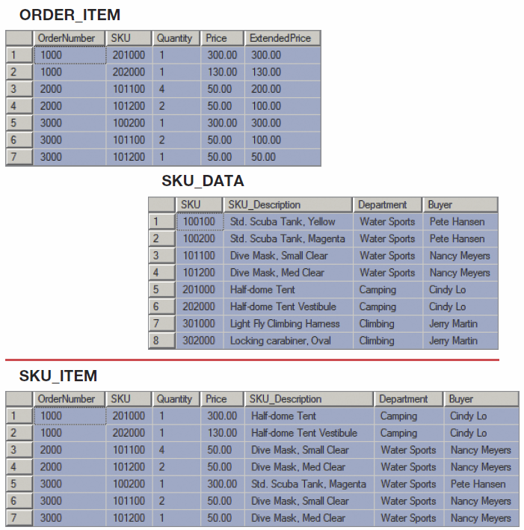
How Many Tables?
Should we store these two tables as they are, or should we combine them into one table in our new database?
KROENKE AND AUER - DATABASE PROCESSING, 12th Edition © 2012 Pearson Prentice Hall
3-<number>

Slide 6
But First—
We need to understand:
  The relational model
  Relational model terminology
KROENKE AND AUER - DATABASE PROCESSING, 12th Edition © 2012 Pearson Prentice Hall
3-<number>

Slide 7
The Relational Model
Introduced in 1970
Created by E.F. Codd
  He was an IBM engineer
  The model used mathematics known as “relational algebra”
Now the standard model for commercial DBMS products.
KROENKE AND AUER - DATABASE PROCESSING, 12th Edition © 2012 Pearson Prentice Hall
3-<number>

Slide 8
Important Relational Model Terms
Entity
Relation
Functional dependency
Determinant
Candidate key
Composite key
Primary key
Surrogate key
Foreign key
Referential integrity constraint
Normal form
Multivalued dependency
KROENKE AND AUER - DATABASE PROCESSING, 12th Edition © 2012 Pearson Prentice Hall
3-<number>

Slide 9
Entity
An entity is some identifiable thing that users want to track:
  Customers
  Computers
  Sales
KROENKE AND AUER - DATABASE PROCESSING, 12th Edition © 2012 Pearson Prentice Hall
3-<number>

Slide 10
Relation
Relational DBMS products store data about entities in relations, which are a special type of table.
A relation is a two-dimensional table that has the following characteristics:
  Rows contain data about an entity.
  Columns contain data about attributes of the entity.
  All entries in a column are of the same kind.
  Each column has a unique name.
  Cells of the table hold a single value.
  The order of the columns is unimportant.
  The order of the rows is unimportant.
  No two rows may be identical.
KROENKE AND AUER - DATABASE PROCESSING, 12th Edition © 2012 Pearson Prentice Hall
3-<number>

Slide 11
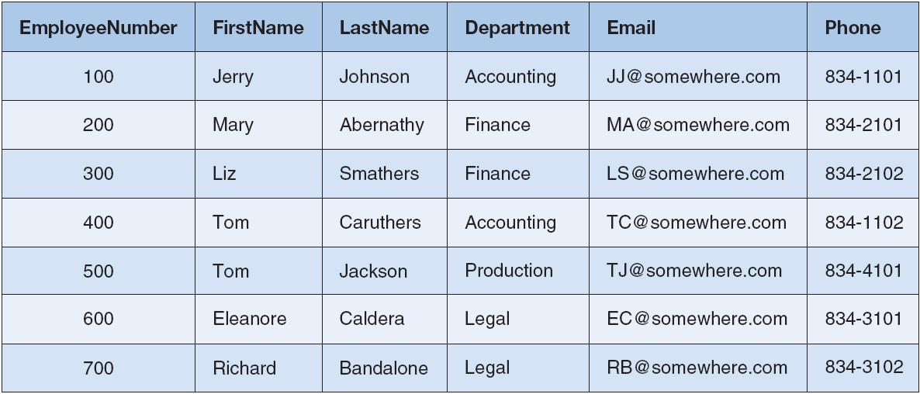
A Relation
KROENKE AND AUER - DATABASE PROCESSING, 12th Edition © 2012 Pearson Prentice Hall
3-<number>

Slide 12
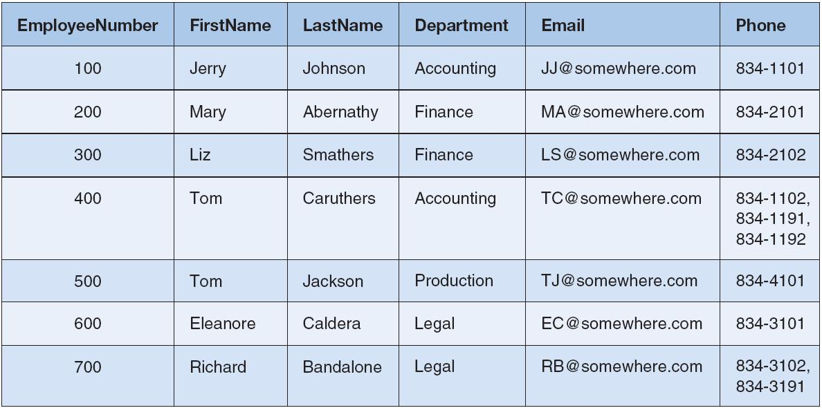
Tables That Are Not Relations:
Multiple Entries per Cell
KROENKE AND AUER - DATABASE PROCESSING, 12th Edition © 2012 Pearson Prentice Hall
3-<number>

Slide 13
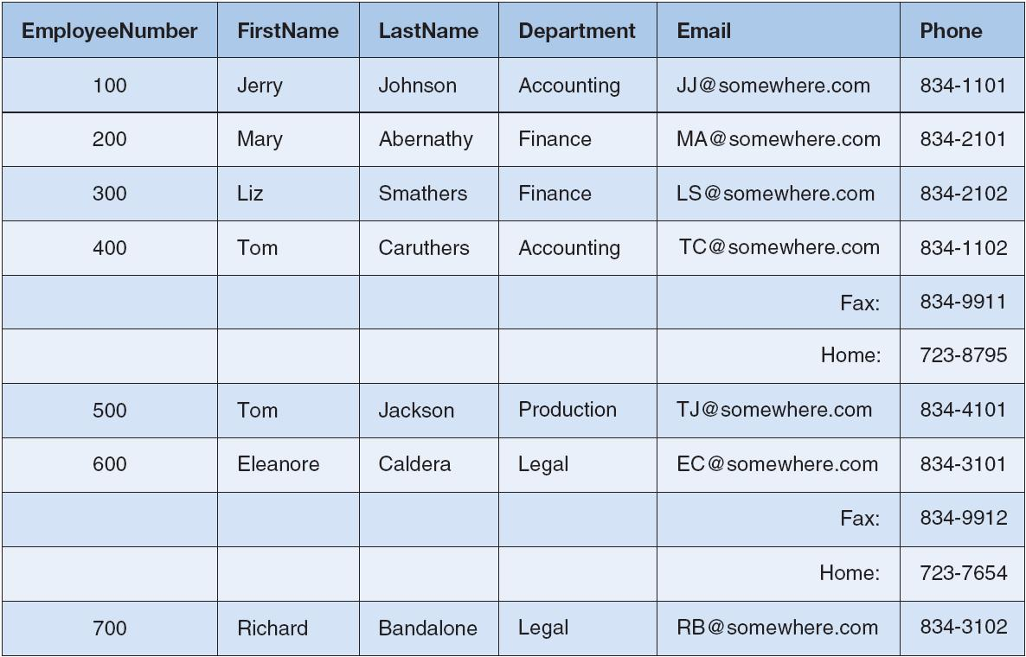
Tables That Are Not Relations:
Table with Required Row Order
KROENKE AND AUER - DATABASE PROCESSING, 12th Edition © 2012 Pearson Prentice Hall
3-<number>

Slide 14
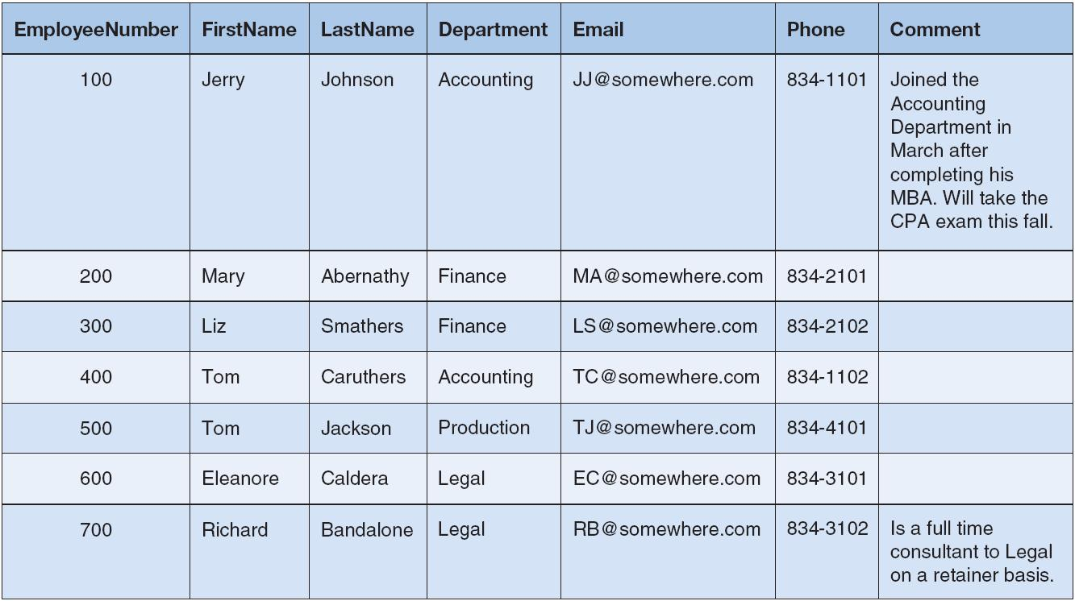
A Relation with Values of Varying Length
KROENKE AND AUER - DATABASE PROCESSING, 12th Edition © 2012 Pearson Prentice Hall
3-<number>

Slide 15
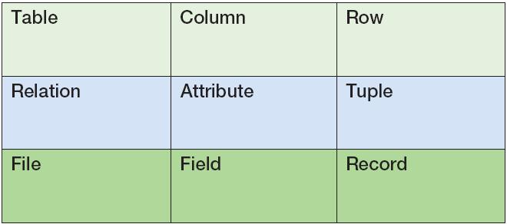
Alternative Terminology
Although not all tables are relations, the terms table and relation are normally used interchangeably.
The following sets of terms are equivalent:
KROENKE AND AUER - DATABASE PROCESSING, 12th Edition © 2012 Pearson Prentice Hall
3-<number>

Slide 16
Functional Dependency
A functional dependency occurs when the value of one (set of) attribute(s) determines the value of a second (set of) attribute(s):
    StudentID → StudentName
    StudentID → (DormName, DormRoom, Fee)
The attribute on the left side of the functional dependency is called the determinant.
Functional dependencies may be based on equations:
  ExtendedPrice = Quantity X UnitPrice
  (Quantity, UnitPrice) → ExtendedPrice
Function dependencies are not equations!
KROENKE AND AUER - DATABASE PROCESSING, 12th Edition © 2012 Pearson Prentice Hall
3-<number>

Slide 17
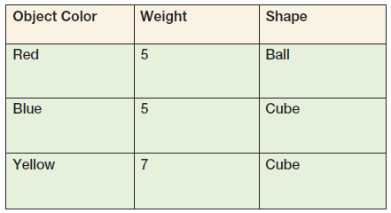
Functional Dependencies Are Not Equations
      ObjectColor → Weight
      ObjectColor → Shape
      ObjectColor → (Weight, Shape)
KROENKE AND AUER - DATABASE PROCESSING, 12th Edition © 2012 Pearson Prentice Hall
3-<number>

Slide 18
Composite Determinants
Composite determinant = a determinant of a functional dependency that consists of more than one attribute
(StudentName, ClassName) → (Grade)
KROENKE AND AUER - DATABASE PROCESSING, 12th Edition © 2012 Pearson Prentice Hall
3-<number>

Slide 19
Functional Dependency Rules
If A → (B, C), then A → B and A→ C.
If (A,B) → C, then neither A nor B determines C by itself.
KROENKE AND AUER - DATABASE PROCESSING, 12th Edition © 2012 Pearson Prentice Hall
3-<number>

Slide 20
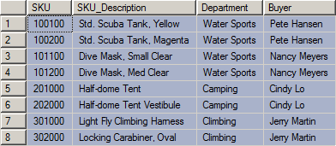
Functional Dependencies in the SKU_DATA Table
KROENKE AND AUER - DATABASE PROCESSING, 12th Edition © 2012 Pearson Prentice Hall
3-<number>

Slide 21
Functional Dependencies in the SKU_DATA Table
SKU → (SKU_Description, Department, Buyer)
SKU_Description → (SKU, Department, Buyer)
Buyer → Department
KROENKE AND AUER - DATABASE PROCESSING, 12th Edition © 2012 Pearson Prentice Hall
3-<number>

Slide 22
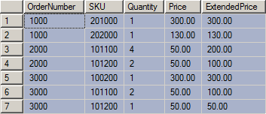
Functional Dependencies in the ORDER_ITEM Table
KROENKE AND AUER - DATABASE PROCESSING, 12th Edition © 2012 Pearson Prentice Hall
3-<number>

Slide 23
Functional Dependencies in the ORDER_ITEM Table
(OrderNumber, SKU) →
(Quantity, Price, ExtendedPrice)
(Quantity, Price) → (ExtendedPrice)
KROENKE AND AUER - DATABASE PROCESSING, 12th Edition © 2012 Pearson Prentice Hall
3-<number>

Slide 24
What Makes Determinant Values Unique?
A determinant is unique in a relation if and only if, it determines every other column in the relation.
You cannot find the determinants of all functional dependencies simply by looking for unique values in one column:
  Data set limitations
  Must be logically a determinant
KROENKE AND AUER - DATABASE PROCESSING, 12th Edition © 2012 Pearson Prentice Hall
3-<number>

Slide 25
Keys
A key is a combination of one or more columns that is used to identify rows in a relation.
A composite key is a key that consists of two or more columns.
KROENKE AND AUER - DATABASE PROCESSING, 12th Edition © 2012 Pearson Prentice Hall
3-<number>

Slide 26
Candidate and Primary Keys
A candidate key is a key that determines all of the other columns in a relation.
A primary key is a candidate key selected as the primary means of identifying rows in a relation.
  There is only one primary key per relation.
  The primary key may be a composite key.
  The ideal primary key is short, numeric, and never changes.
KROENKE AND AUER - DATABASE PROCESSING, 12th Edition © 2012 Pearson Prentice Hall
3-<number>

Slide 27
Surrogate Keys
A surrogate key is an artificial column added to a relation to serve as a primary key.
  DBMS supplied
  Short, numeric, and never changes—an ideal primary key
  Has artificial values that are meaningless to users
  Normally hidden in forms and reports
KROENKE AND AUER - DATABASE PROCESSING, 12th Edition © 2012 Pearson Prentice Hall
3-<number>

Slide 28
Surrogate Keys
NOTE: The primary key of the relation is underlined below:
RENTAL_PROPERTY without surrogate key:
RENTAL_PROPERTY (Street, City,
State/Province, Zip/PostalCode, Country, Rental_Rate)
RENTAL_PROPERTY with surrogate key:
  RENTAL_PROPERTY (PropertyID, Street, City,
  State/Province, Zip/PostalCode, Country, Rental_Rate)
KROENKE AND AUER - DATABASE PROCESSING, 12th Edition © 2012 Pearson Prentice Hall
3-<number>

Slide 29
Foreign Keys
A foreign key is the primary key of one relation that is placed in another relation to form a link between the relations.
  A foreign key can be a single column or a composite key.
  The term refers to the fact that key values are foreign to the relation in which they appear as foreign key values.
KROENKE AND AUER - DATABASE PROCESSING, 12th Edition © 2012 Pearson Prentice Hall
3-<number>

Slide 30
Foreign Keys
NOTE: The primary keys of the relations are underlined and any foreign keys are in italics in the relations below:
DEPARTMENT (DepartmentName, BudgetCode, ManagerName)
EMPLOYEE (EmployeeNumber, EmployeeLastName,
EmployeeFirstName, DepartmentName)
KROENKE AND AUER - DATABASE PROCESSING, 12th Edition © 2012 Pearson Prentice Hall
3-<number>

Slide 31
The Referential Integrity Constraint
A referential integrity constraint is a statement that limits the values of the foreign key to those already existing as primary key values in the corresponding relation.
KROENKE AND AUER - DATABASE PROCESSING, 12th Edition © 2012 Pearson Prentice Hall
3-<number>

Slide 32
Foreign Key with a
Referential Integrity Constraint
NOTE: The primary key of the relation is underlined and any foreign keys are in italics in the relations below:
SKU_DATA (SKU, SKU_Description, Department, Buyer)
ORDER_ITEM (OrderNumber, SKU, Quantity, Price,
ExtendedPrice)
Where ORDER_ITEM.SKU must exist in SKU_DATA.SKU
KROENKE AND AUER - DATABASE PROCESSING, 12th Edition © 2012 Pearson Prentice Hall
3-<number>

Slide 33
Modification Anomalies
Deletion anomaly
Insertion anomaly
Update anomaly
KROENKE AND AUER - DATABASE PROCESSING, 12th Edition © 2012 Pearson Prentice Hall
3-<number>

Slide 34
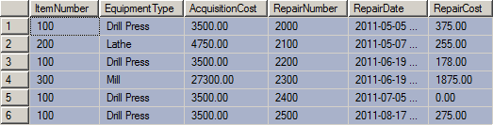

Modification Anomalies
The EQUIPMENT_REPAIR table before and after an incorrect update operation on AcquisitionCost for Type = Drill Press:
KROENKE AND AUER - DATABASE PROCESSING, 12th Edition © 2012 Pearson Prentice Hall
3-<number>

Slide 35
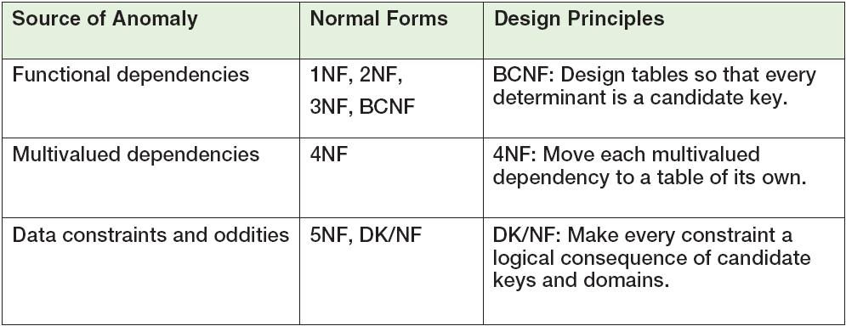
Normal Forms
Relations are categorized as a normal form based on which modification anomalies or other problems they are subject to:
KROENKE AND AUER - DATABASE PROCESSING, 12th Edition © 2012 Pearson Prentice Hall
3-<number>

Slide 36
Normal Forms
1NF—a table that qualifies as a relation is in 1NF.
2NF—a relation is in 2NF if all of its nonkey attributes are dependent on all of the primary keys.
3NF—a relation is in 3NF if it is in 2NF and has no determinants except the primary key.
Boyce-Codd Normal Form (BCNF)—a relation is in BCNF if every determinant is a candidate key.
“I swear to construct my tables so that all nonkey
columns are dependent on the key, the whole key and nothing but the key, so help me Codd.”
KROENKE AND AUER - DATABASE PROCESSING, 12th Edition © 2012 Pearson Prentice Hall
3-<number>

Slide 37
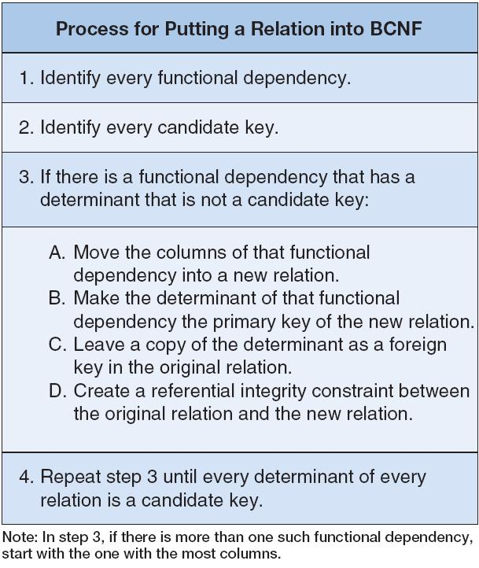
Eliminating Modification Anomalies from Functional Dependencies in Relations:
Put All Relations into BCNF
KROENKE AND AUER - DATABASE PROCESSING, 12th Edition © 2012 Pearson Prentice Hall
3-<number>

Slide 38
Putting a Relation into BCNF:
EQUIPMENT_REPAIR
KROENKE AND AUER - DATABASE PROCESSING, 12th Edition © 2012 Pearson Prentice Hall
3-<number>

Slide 39
Putting a Relation into BCNF:
EQUIPMENT_REPAIR
EQUIPMENT_REPAIR (ItemNumber, Type, AcquisitionCost,
RepairNumber, RepairDate, RepairAmount)
ItemNumber → (Type, AcquisitionCost)
RepairNumber → (ItemNumber, Type, AcquisitionCost,
RepairDate, RepairAmount)
ITEM (ItemNumber, Type, AcquisitionCost)
REPAIR (RepairNumber, ItemNumber, RepairDate, RepairAmount)
Where REPAIR.ItemNumber must exist in ITEM.ItemNumber
KROENKE AND AUER - DATABASE PROCESSING, 12th Edition © 2012 Pearson Prentice Hall
3-<number>

Slide 40
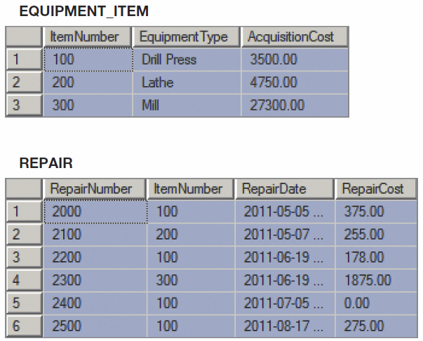
Putting a Relation into BCNF:
New Relations
KROENKE AND AUER - DATABASE PROCESSING, 12th Edition © 2012 Pearson Prentice Hall
3-<number>

Slide 41
Putting a Relation into BCNF:
SKU_DATA Step-by-Step – 1NF
SKU_DATA (SKU, SKU_Description, Department, Buyer)
1NF - Checking against the definition of 1NF, this relation is in 1NF.
KROENKE AND AUER - DATABASE PROCESSING, 12th Edition © 2012 Pearson Prentice Hall
3-<number>

Slide 42
Putting a Relation into BCNF:
SKU_DATA Step-by-Step – 2NF
SKU_DATA (SKU, SKU_Description, Department, Buyer)
SKU → (SKU_Description, Department, Buyer)
SKU_Description → (SKU, Department, Buyer)
Buyer → Department
— SKU and SKU_Description are candidate keys.
— A relation is in 2NF if and only if it is in 1NF and all non-key attributes are determined by the primary key.
— Since SKU is a single column primary key, all non-key attributes are determined by SKU, and the relation is in 2NF.
KROENKE AND AUER - DATABASE PROCESSING, 12th Edition © 2012 Pearson Prentice Hall
3-<number>

Slide 43
Putting a Relation into BCNF:
SKU_DATA Step-by-Step – 3NF
SKU_DATA (SKU, SKU_Description, Department, Buyer)
SKU → (SKU_Description, Department, Buyer)
SKU_Description → (SKU, Department, Buyer)
Buyer → Department
— SKU and SKU_Description are candidate keys.
— A relation is in 3NF if and only if it is in 2NF and there are no non-key attributes determined by another non-key attribute.
— However, the term non-key attribute means an attribute that is neither (1) a candidate key itself, nor (2) part of a composite candidate key.
— Therefore, the only non key attribute is Buyer, and it is a determinant. — Therefore, not in 3NF.
KROENKE AND AUER - DATABASE PROCESSING, 12th Edition © 2012 Pearson Prentice Hall
3-<number>

Slide 44
Putting a Relation into BCNF:
SKU_DATA Step-by-Step – 3NF
— Therefore, break out the Buyer → Department functional dependency.
SKU_DATA_2 (SKU, SKU_Description, Buyer)
BUYER (Buyer, Department)
Where SKU_DATA_2.Buyer must exist in BUYER.Buyer
— SKU_DATA_2 is in 3NF
— BUYER is in 3NF
KROENKE AND AUER - DATABASE PROCESSING, 12th Edition © 2012 Pearson Prentice Hall
3-<number>

Slide 45
Putting a Relation into BCNF:
SKU_DATA Step-by-Step – BCNF
SKU_DATA_2 (SKU, SKU_Description, Buyer)
BUYER (Buyer, Department)
Where SKU_DATA_2.Buyer must exist in BUYER.Buyer
SKU → (SKU_Description, Department, Buyer)
SKU_Description → (SKU, Department, Buyer)
Buyer → Department
— A relation is in BCNF if and only if it is in 3NF and every determinant is a candidate-key.
— In SKU_DATA_2, both determinants are determinant keys, so SKU_DATA_2 is in BCNF.
— In BUYER, the determinant is a determinant key, so BUYER is in BCNF.
KROENKE AND AUER - DATABASE PROCESSING, 12th Edition © 2012 Pearson Prentice Hall
3-<number>

Slide 46
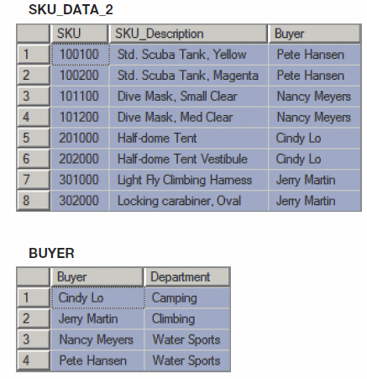
Putting a Relation into BCNF:
SKU_DATA Step-by-Step – New Relations
KROENKE AND AUER - DATABASE PROCESSING, 12th Edition © 2012 Pearson Prentice Hall
3-<number>

Slide 47
Putting a Relation into BCNF:
SKU_DATA Straight-to-BCNF
KROENKE AND AUER - DATABASE PROCESSING, 12th Edition © 2012 Pearson Prentice Hall
3-<number>

Slide 48
Putting a Relation into BCNF:
SKU_DATA Straight-to-BCNF
SKU_DATA (SKU, SKU_Description, Department, Buyer)
SKU → (SKU_Description, Department, Buyer)
SKU_Description → (SKU, Department, Buyer)
Buyer → Department
— Therefore, break out the Buyer → Department functional dependency.
SKU_DATA (SKU, SKU_Description, Buyer)
BUYER (Buyer, Department)
Where BUYER.Buyer must exist in SKU_DATA.Buyer
KROENKE AND AUER - DATABASE PROCESSING, 12th Edition © 2012 Pearson Prentice Hall
3-<number>

Slide 49
Putting a Relation into BCNF:
SKU_DATA Straight-to-BCNF New Relations
KROENKE AND AUER - DATABASE PROCESSING, 12th Edition © 2012 Pearson Prentice Hall
3-<number>

Slide 50
Multivalued Dependencies
A multivalued dependency occurs when a determinant is matched with a particular set of values:
Employee →→ Degree
  Employee →→ Sibling
  PartKit →→ Part
The determinant of a multivalued dependency can never be a primary key.
KROENKE AND AUER - DATABASE PROCESSING, 12th Edition © 2012 Pearson Prentice Hall
3-<number>

Slide 51
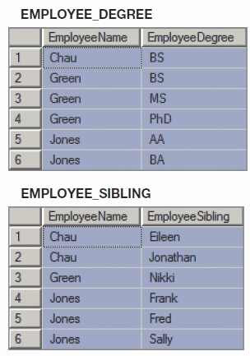
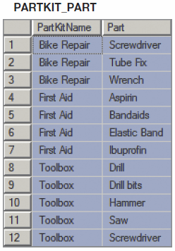
Multivalued Dependencies
KROENKE AND AUER - DATABASE PROCESSING, 12th Edition © 2012 Pearson Prentice Hall
3-<number>

Slide 52
Eliminating Anomalies from Multivalued Dependencies
Multivalued dependencies are not a problem if they are in a separate relation, so:
  Always put multivalued dependencies into their own relation.
  This is known as Fourth Normal Form (4NF).
KROENKE AND AUER - DATABASE PROCESSING, 12th Edition © 2012 Pearson Prentice Hall
3-<number>

Slide 53
David Kroenke and David Auer
Database Processing
Fundamentals, Design, and Implementation
(12th Edition)
End of Presentation:
Chapter Three
KROENKE AND AUER - DATABASE PROCESSING, 12th Edition © 2012 Pearson Prentice Hall
3-<number>

Slide 54

All rights reserved. No part of this publication may be reproduced, stored in a retrieval system, or transmitted, in any form or by any means, electronic, mechanical, photocopying, recording, or otherwise, without the prior written permission of the publisher. Printed in the United States of America.
Copyright © 2012 Pearson Education, Inc.
Publishing as Prentice Hall
KROENKE AND AUER - DATABASE PROCESSING, 12th Edition © 2012 Pearson Prentice Hall
3-<number>

